Slide 1
Finance Credit Team Sprint Update 6
December 3rd, 2023
Lucas | Kendall | lakendal@mtu.edu
Trent | Magers | tfmagers@mtu.edu
Emily | Wood | Ewood@mtu.edu
Reyn | White | walterw@mtu.edu
Irene | Trierweiler | Iltrierw@mtu.edu
Joseph | Williams | jokwilli@mtu.edu
Atharva | Joshi | atharvaj@mtu.edu
John | Mware | jmware@mtu.edu

Slide 2
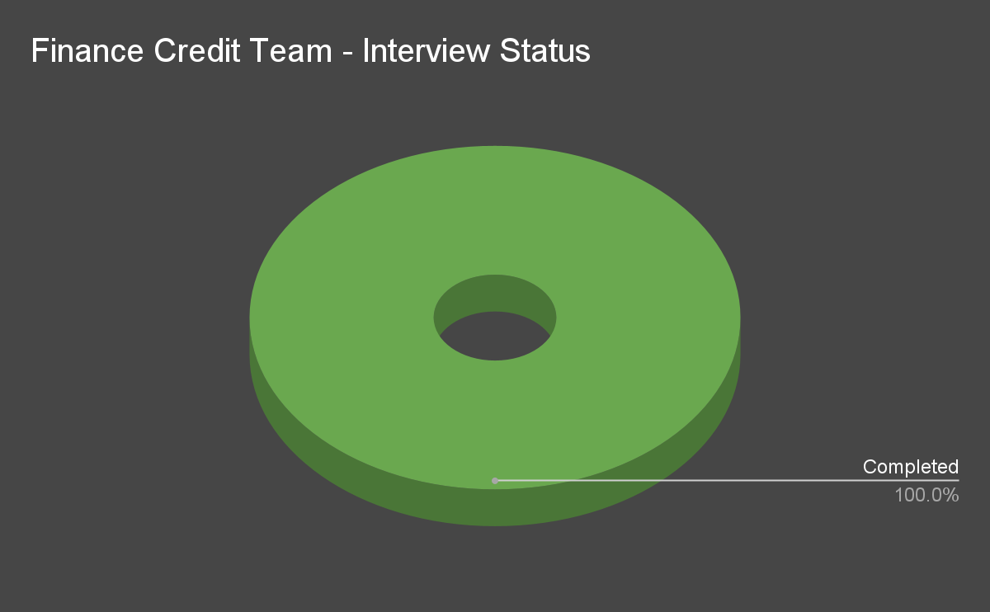
Interviews Status

Slide 3
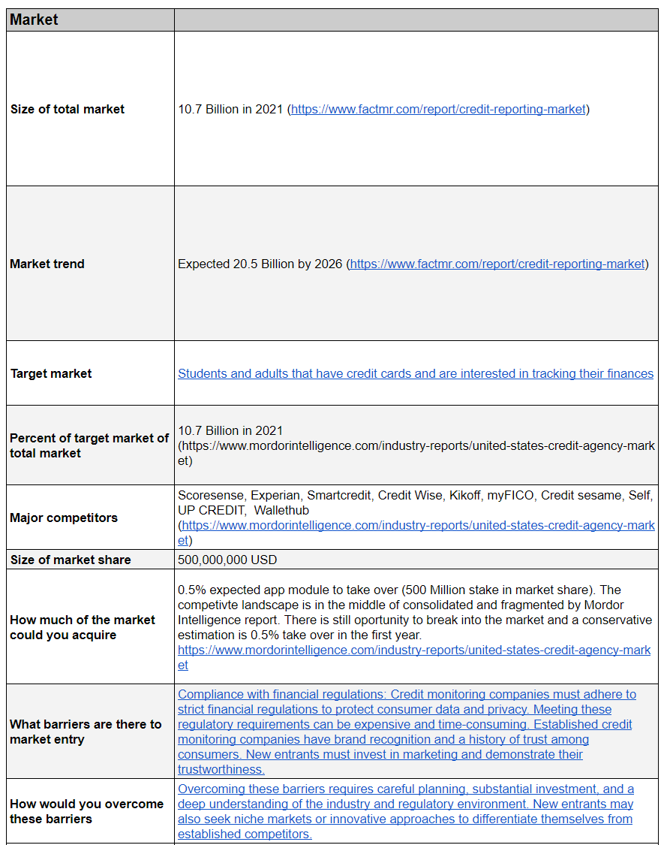
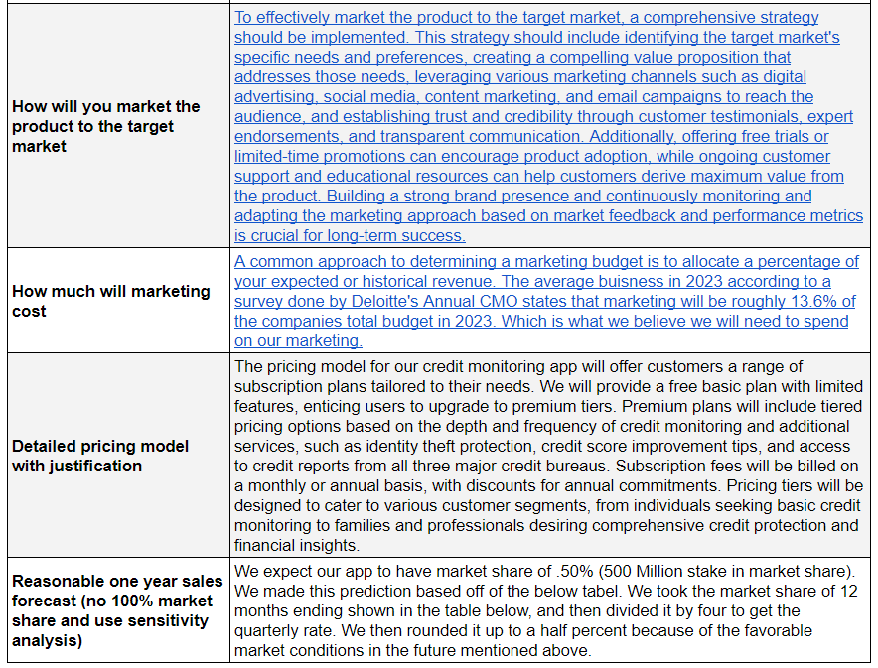
Business Portfolio - Questions

Slide 4
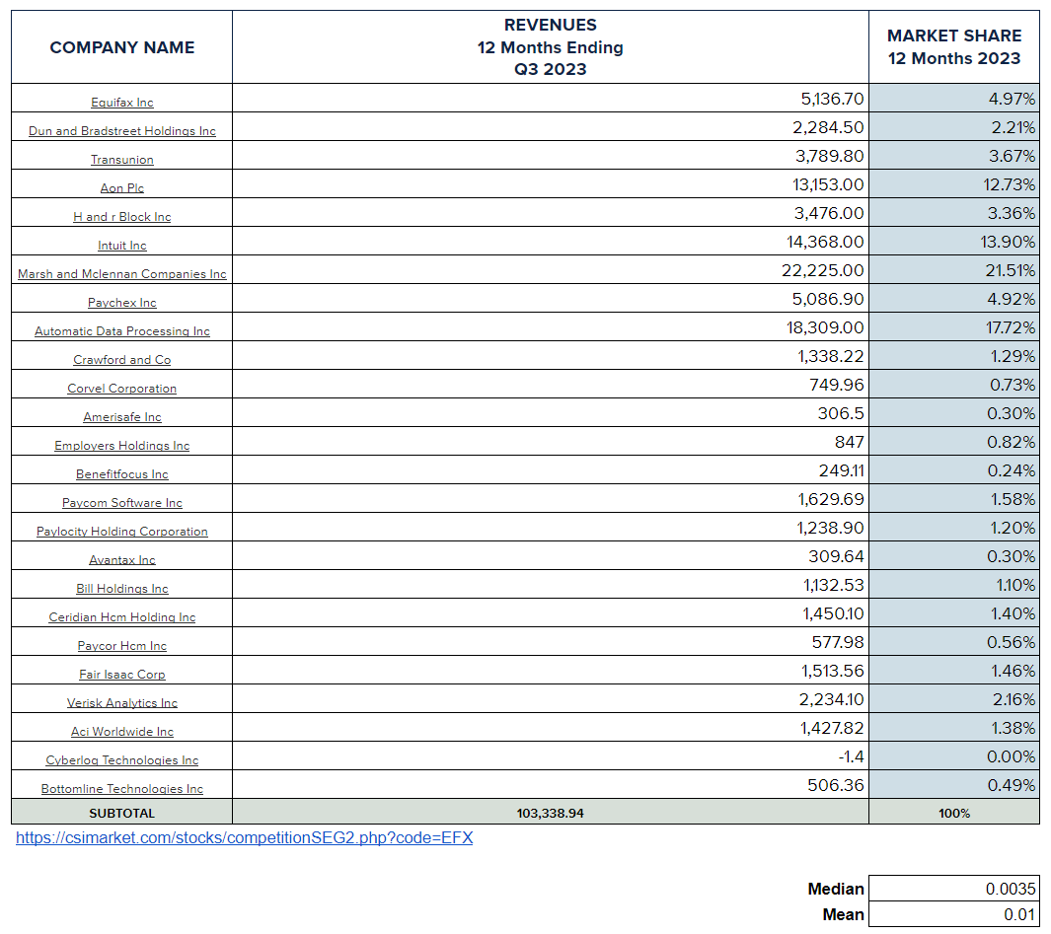
Business Portfolio - Questions

Slide 5
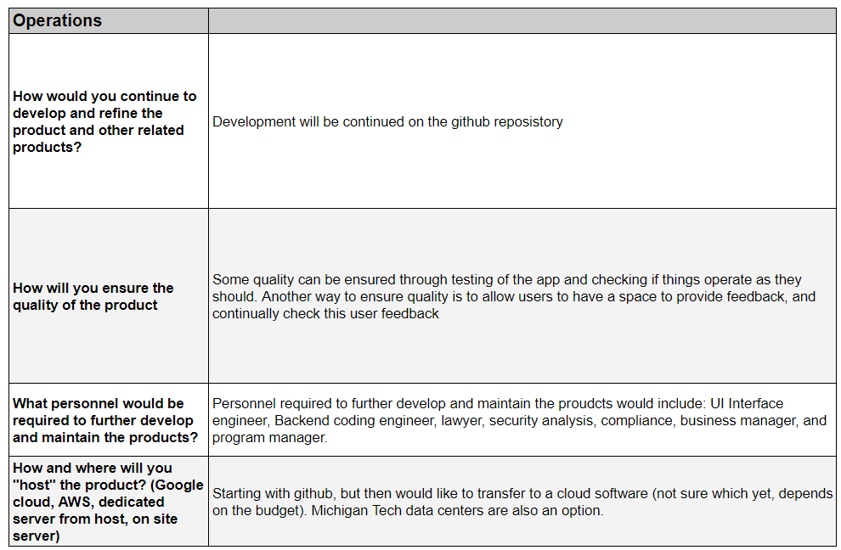
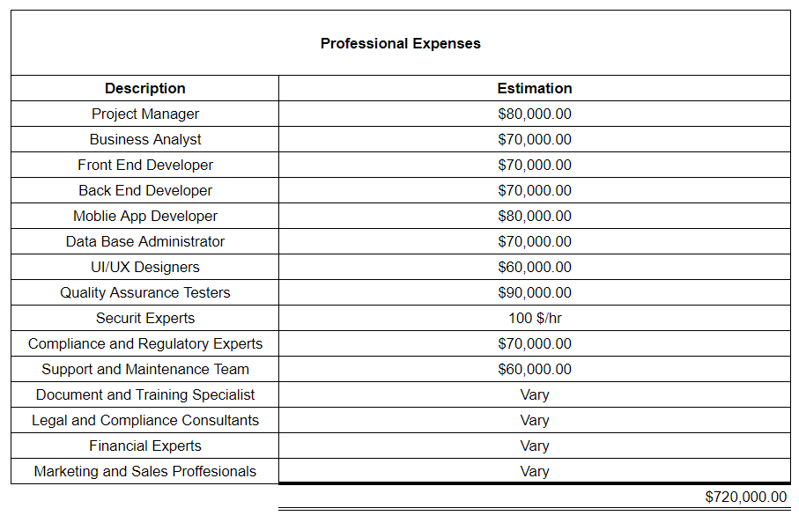
Business Portfolio - Questions

Slide 6
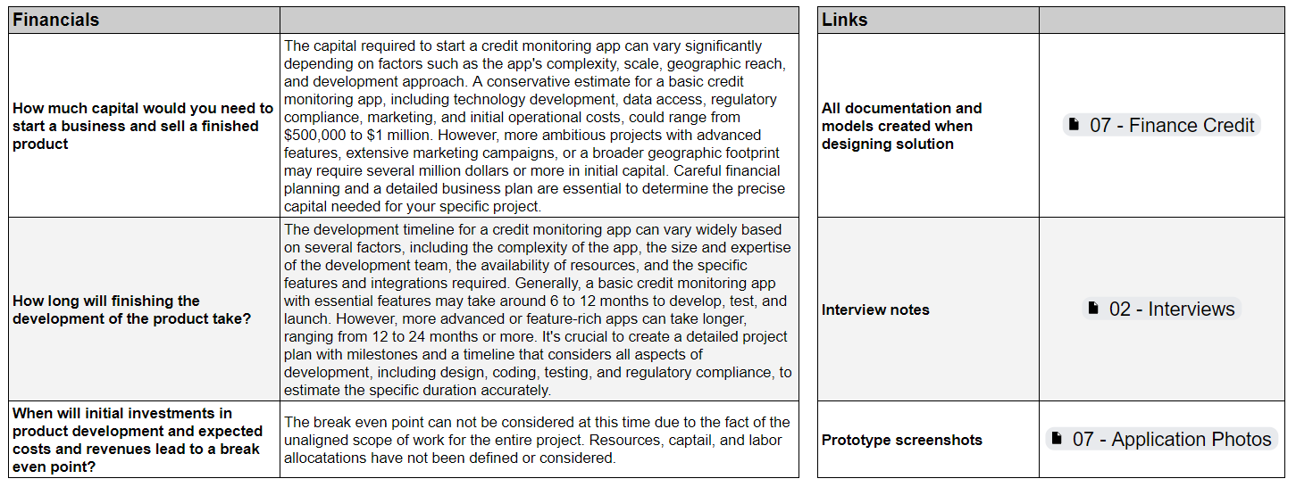
Business Portfolio - Questions

Slide 7
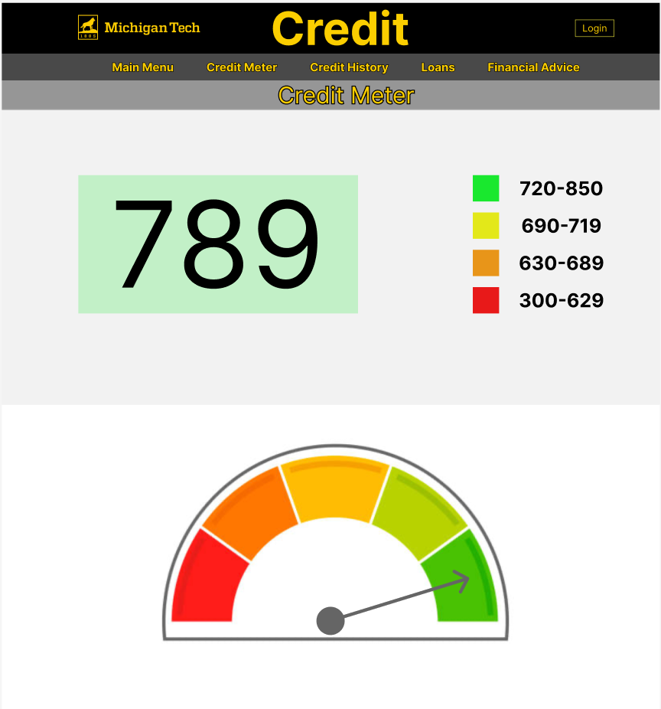
Application Development - Front End

Slide 8
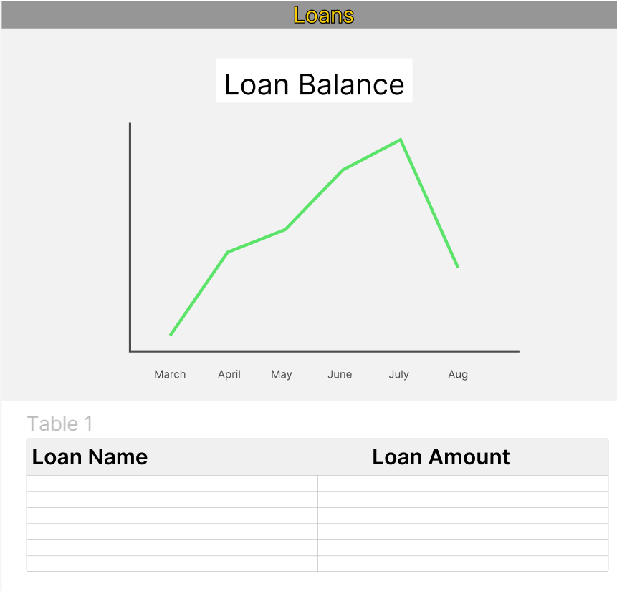
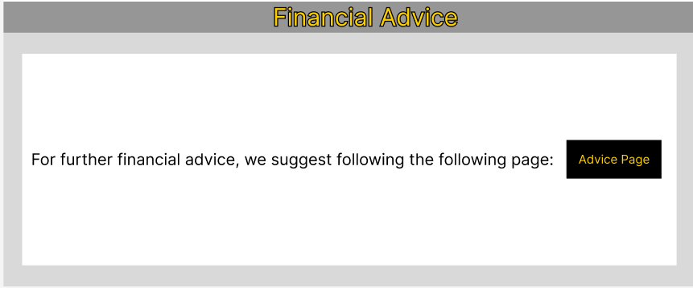
Application Development - Front End

Slide 9
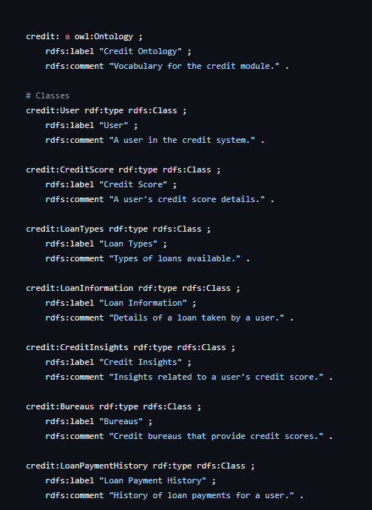
Github Ontology

Slide 10
Steps Moving Forward
Interviews
Completed
Front End Cross Development
Completed
Business Case Development
Completed, Followed up with Krissa and Jake requesting if they need support.
Github Cleanup
Completed
Trello Project Tracking
Closed out action items

